Slide 1
The 4 Disciplines of Execution
Troy, Michigan
December 4-5,2012

Slide 2
Strategic Planning
Why do we exist?
Mission Statement
What does success look like?
Vision Statement
How do we get there?
Strategic Plan
Stroke of the Pen
Behavior Change
Day to Day

Slide 3
Strategic Planning
Why does the organization exist?
Mission Statement
“Gain. Retain. Serve.”
What does success look like?
Vision Statement
“To provide World Class Customer Service to everyone we meet. And to provide the highest value and quality services possible.”
How do we get there?
Strategic Plan

Slide 4
Strategic Planning
3 Distinct Categories of Actions
Stroke of The Pen
If the resources are available, these decisions are made and put into place.
Day to Day Operations (The Whirlwind)
The bottom line (Financial)
Processes and Programs (Operational
Employee development and training (Employee)
Customer Satisfaction and Market Share (Customer)
Behavior Change

Slide 5
Behavior Change
The most difficult part of executing the Strategic Plan is changing human behavior.
If the organization wants different results, the organization must do something different
People resist change not because they don’t like change, but because they are comfortable with the way things are.
The 4 Disciplines of Execution (4DX) provides a pathway for behavior change

Slide 6
The 4 Disciplines of Execution
The goal of 4DX is to create habits to achieve the WIG
The process is counterintuitive
We must say “No” to good ideas
Says easy, does hard

Slide 7
The 4 Disciplines of Execution
Focus on The Wildly Important
Act on Lead Measures
Create a Compelling Scoreboard
Create a Cadence of Accountability

Slide 8
Focus on The Wildly Important (WIG)
The WIG is defined as the War. The one goal that if not reached will render all other goals meaningless
Each organization should have no more that 1 or 2 WIGs.
Each division may have sub-WIGs (battles), but those sub-WIGs must support the organization’s WIG
The goal is to identify the least number of battles necessary to win the War.
Defined as: “From X to Y by when”

Slide 9
Act on Lead Measures
Lag Measure vs. Lead Measure
Lag measures are a measurement of something that has already happened (the outcome)
Lead measures are a measurement of behavior or actions
The Lead Measure is a calculated bet that, if achieved, will positively affect progress on the WIG
Lead Measures must be predictive and influencable

Slide 10
Create a Compelling Scoreboard
People are playing different when they are keeping score
The scoreboard is Simple
The scoreboard is Highly Visible
The scoreboard has The Right Lead and Lag Measures
The scoreboard tells us immediately if you are Winning or Losing

Slide 11
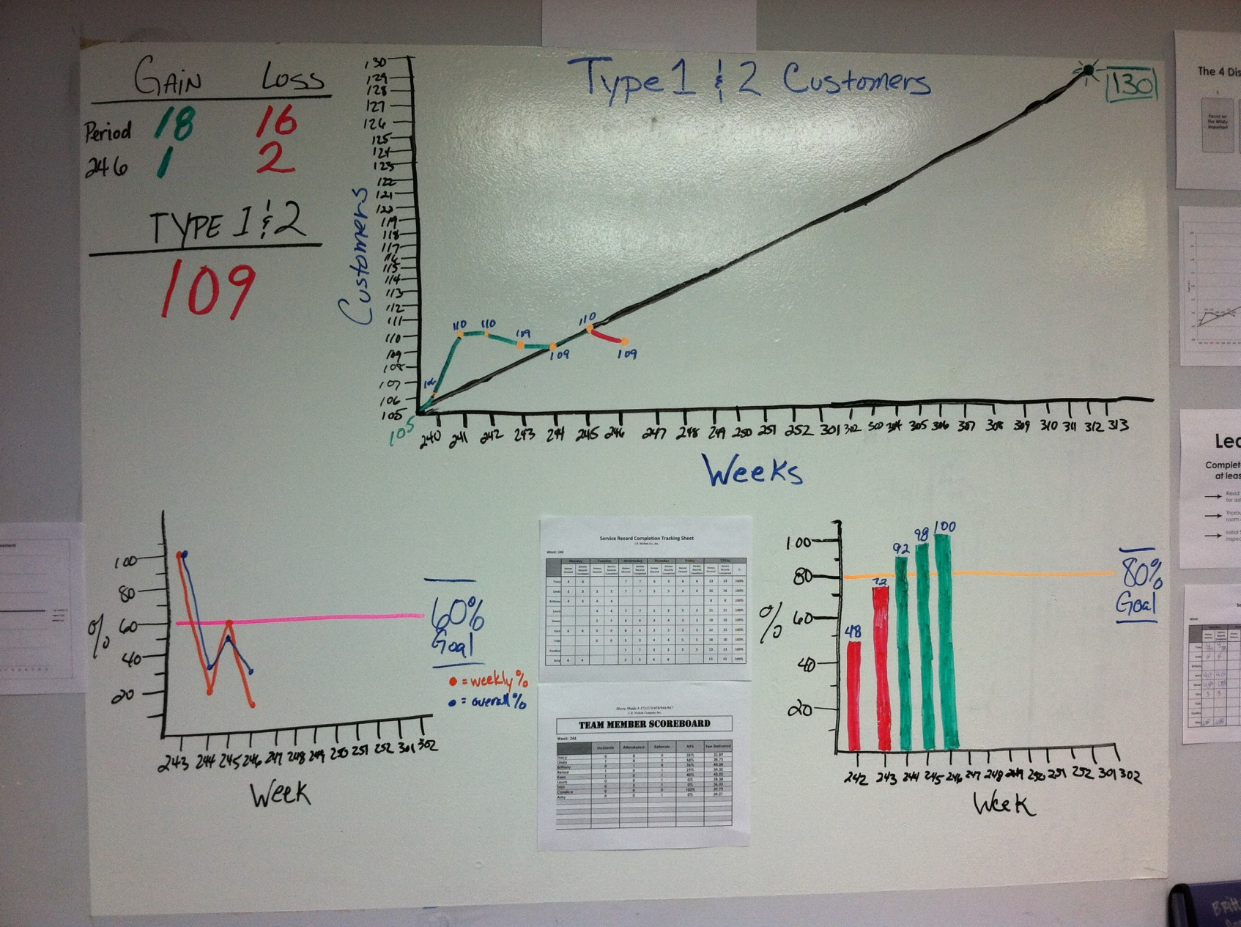
Sample Scoreboard

Slide 12
Create a Cadence of Accountability
Weekly Company Meetings
15-20 minutes in length
Agenda:
Report on Last Week’s Commitment
Review and Update the Scoreboard
Make Commitments for the Next Week
“What are the 1 or 2 most important things I can do THIS WEEK to impact the team’s performance on the scoreboard?”

Slide 13
Create a Cadence of Accountability
Weekly Team Meetings
10-15 Minutes in Length
Review and Update the Scoreboard
Discuss Lead Measure Activity
Leader makes commitments to help the team for the next week

Slide 14
4DX Office Implementation
Review 4DX program with Team Members
Develop Lead Measures
1 or 2 for Gaining Customers
1 or 2 for Keeping Customers
1 or 2 for Quality Control
Create Scoreboard
Schedule Team Meetings

Slide 15
WIG
Company WIG
Increase weekly sales from $22k to $30k by 352
Increase Type 1 & 2 from 105 to 130 by 313
Increase Type 1 & 2 from 181 to 225 by 313
Increase Type 1 & 2 from 52 to 68 by 313
Livonia WIG
Troy WIG
Peoria WIG

Slide 16
Lead Measures
Get
Keep
Quality
Close 60% of Estimates with MMA Agreement
Contact 5 Type 3,4, & 5 Customers and Former Customers per week and offer MMA
Distribute 5 Doorhangers at 90% of Homes Weekly
Inspect each others work and correct problems in 90% of homes. Identify 1 positive and 1 negative thing that was found in each home inspected
Send same team to weekly/bi-weekly customers 80% of the time
Perform 2 Quality Checks per person per week.
Contact new customer each cleaning for the first 3 cleanings 80% of the time. (At least one contact must be a physical inspection)

